Slide 1
Edge
AI Education at the Last Mile
UM – Gunners · University of Malaya · Malaysia
Track: AI for Education · ASEAN AI Hackathon 2026

Slide 2
THE CHALLENGE
60M+ rural learners, left offline
60M+
rural ASEAN learners excluded
no internet · no grid · no mother-tongue AI
18%
rural internet (Timor-Leste)
25% Myanmar · 28% Laos (ITU 2023)
55%
Filipino 15-yos below PISA maths
30% Cambodian G5 read (UNICEF 2019)
• Cloud AI (ChatGPT, etc.) is built for the connected world and fails entirely off-grid
• The communities with the least connectivity have the least access to quality tutoring
• Mother-tongue and minority-language learners are unserved by dominant-language models
Edge — AI Education at the Last Mile · UM-Gunners

Slide 3
THE SOLUTION
An offline AI tutor on a $220 solar hub
• A fully offline, solar-powered AI tutoring hub on a Raspberry Pi — broadcasts local Wi-Fi
• Students connect from their own phones, no internet; an Agentic RAG pipeline answers in their mother tongue
• Curriculum-grounded answers, adaptive quizzes, voice interaction, PDF microcredentials
100% Offline
no internet, ever
Mother-tongue
incl. Iban, Cebuano
Grounded
0% hallucination
$0.60 / student / yr
solar, no cloud fees
Edge — AI Education at the Last Mile · UM-Gunners

Slide 4
COMPETITIVE ADVANTAGE
Why Edge, not the cloud
Cloud AI (ChatGPT…)
✕ Needs constant internet
✕ Recurring subscription cost
✕ Dominant languages only
✕ Ungrounded — hallucinates
✕ No teacher analytics / governance
Edge
✓ Runs 100% offline on solar
✓ ≈$0.60/student/yr, no fees
✓ Mother-tongue incl. low-resource
✓ Curriculum-grounded, 0% false-grounding
✓ Teacher dashboard + full governance
Edge — AI Education at the Last Mile · UM-Gunners

Slide 5
TECHNICAL ARCHITECTURE
A 4-agent offline Agentic RAG pipeline
Voice / text query (dialect)
1. Translation Agent
2. Personalised Context
3. Pedagogical Reasoning
4. Verification Agent
Grounded mother-tongue answer + citations
Knowledge: ChromaDB (cross-lingual vectors over OER PDFs) · SQLite (profiles, progress, audit)
Hardware (100% offline): Solar panel → battery → Raspberry Pi → Wi-Fi router → students' phones · two-node split for memory-constrained Pis
Edge — AI Education at the Last Mile · UM-Gunners

Slide 6
AI APPROACH
Open-weight models, chosen for the edge
Phi-3 Mini
4-bit GGUF · Ollama
Reasoning & tutoring — small enough for on-device inference
MiniLM-L12 (multilingual)
paraphrase-multilingual
Cross-lingual retrieval — the key to the bias fix
NLLB-200-distilled-600M
+ glossary bridge
NMT across ASEAN languages; bridge for non-NLLB dialects
Whisper.cpp + Piper
ggml-base
Offline speech-to-text and text-to-speech
Why: open-weight, permissively licensed, ARM-optimised, fully offline.
Edge — AI Education at the Last Mile · UM-Gunners

Slide 7
DATA STRATEGY
Curated, licensed, cleaned
• Curriculum: OpenStax (CC BY 4.0) + national OER from KPM, DepEd, Kemendikbud + team-authored lessons
• Translation references: open VynerCK/Iban-language-data + teacher-verified corrections (the Dialect Flywheel)
• Cleaning: manual curation against ministry standards · page-level chunking · idempotent ingestion
• Integrity: versioned, provenance-tracked content manifest with enforced tamper quarantine
Licensing
OpenStax CC BY 4.0 · Phi-3 MIT · Piper Apache 2.0 · NLLB-200 CC BY-NC 4.0 · Iban/Cebuano CC BY 4.0
Edge — AI Education at the Last Mile · UM-Gunners

Slide 8
AI ETHICS & RESPONSIBILITY
Bias: measured, then mitigated
✓ 100% of questions answered in EVERY language tested — 0% non-response. No student is ever left without an answer.
• Same question, varied language: a measured bias (English 100% vs Thai 50% grounding)
• Root cause: query translation degraded retrieval
• Fix: cross-lingual retrieval → Thai/Viet 62%, Iban fully closed
Privacy & governance
RBAC + per-teacher audit log · encryption (LUKS + encrypted USB) · parental consent record · retention purge & right-to-erasure
Edge — AI Education at the Last Mile · UM-Gunners

Slide 9
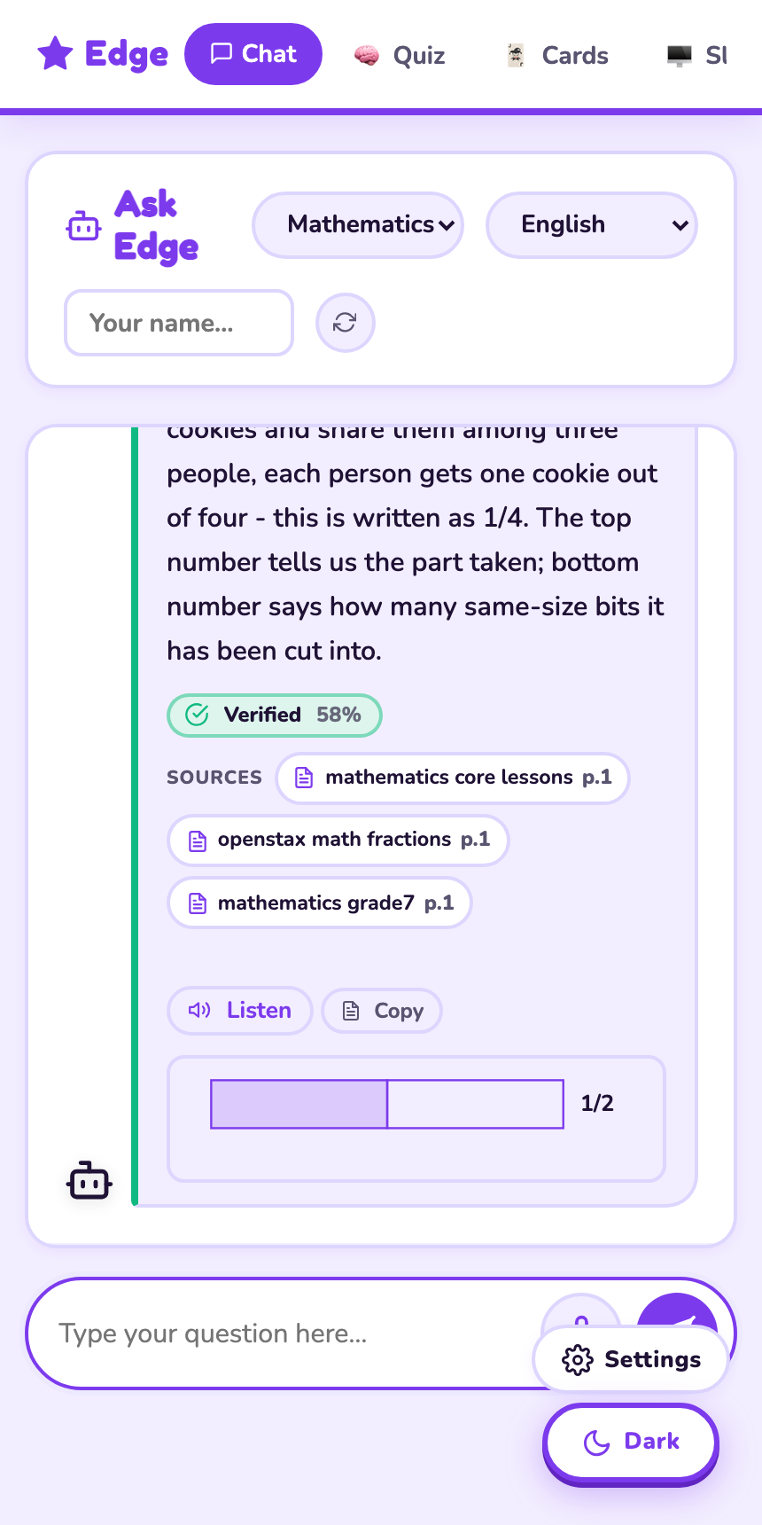
PROTOTYPE DEMONSTRATION
The AI, grounded and transparent
• Real grounded answer with page-level citations (3 sources shown)
• Green “Verified” confidence badge — transparent about certainty
• Auto-generated fraction diagram — visual, mother-tongue ready
• Tiered logic: grounded → supplementary → controlled non-response
• Mobile-first PWA: students use their own phones, fully offline
▶ Demo video: https://youtu.be/Ms_y6FUbKwU
Edge — AI Education at the Last Mile · UM-Gunners

Slide 10
TECHNICAL HURDLES
Honest reflection — problem → fix
Hallucination in low-context queries
Verification Agent + tiered distance gates
Automated LLM judges unreliable (3.4–97%)
Validate answer correctness with humans
Translation “looked weak” (chrF 28)
Measurement bug — real chrF is 56
Query translation degraded retrieval
Cross-lingual retrieval (closed the bias gap)
Memory pressure on a 4 GB Pi
Admission queue + TTS offload + two-node split
Edge — AI Education at the Last Mile · UM-Gunners

Slide 11
ACCURACY & EFFICIENCY METRICS
Measured, not claimed
100%
Retrieval recall
right source always found
0%
Hallucination
no false grounding
~97%
Concept coverage
answers contain key facts
56
Iban chrF
decent; flywheel grows it
Honest caveat
We report concept coverage, not a single automated “accuracy %”: small LLM judges scored the same answers 3.4–97%, so answer correctness is being validated by human raters.
Load test (dev node): 0 errors under the admission queue; throughput plateaus at the single-stream SLM rate. On-Pi benchmarking is the next step.
Edge — AI Education at the Last Mile · UM-Gunners

Slide 12
SCALABILITY ROADMAP
From one school to the region
1 Hub
~50 connected students, admission-controlled
1 School
two-node split for higher concurrency
Many Schools
decentralised content manifest + USB sync
ASEAN-wide
per-hub language configuration
• No internet needed to update or scale — encrypted USB sneakernet deploys content & DB updates
• Ministries, NGOs, schools and teachers publish curriculum independently (provenance-tracked)
Edge — AI Education at the Last Mile · UM-Gunners

Slide 13
IMPACT ASSESSMENT
Aligned with the UN SDGs
SDG 4
Quality Education
curriculum-grounded tutoring at the last mile
SDG 10
Reduced Inequalities
mother-tongue access for underserved learners
SDG 9
Infrastructure & Innovation
resilient off-grid education infrastructure
Regional resilience: learning continuity off-grid and in crises; preservation of minority languages via the ASEAN Dialect Flywheel — a public good of minority-language AI infrastructure.
Edge — AI Education at the Last Mile · UM-Gunners

Slide 14
FUTURE ROADMAP
Next steps after the hackathon
• Micro-pilot in rural schools → measured learning outcomes (pre/post, small-n)
• On-Pi benchmarking + two-node deployment validation
• Fluent-speaker translation audit → sentence-level chrF; grow the dialect-glossary flywheel
• Stronger embedder / fine-tuned MT as teacher-verified data accrues
• Hardening: encryption rollout, parental-consent workflow, retention automation
Edge — AI Education at the Last Mile · UM-Gunners

Slide 15
Team & Contact
UM – Gunners · University of Malaya · Malaysia
[ Member 1 ]
Role / contribution
[ Member 2 ]
Role / contribution
[ Member 3 ]
Role / contribution
Repository: github.com/fciacia/EduNode
Demo: youtu.be/Ms_y6FUbKwU · [ add university logo ]

